Slide 1




ARROW: Restoration-Aware Traffic Engineering
Zhizhen Zhong
MIT CSAIL
Manya Ghobadi
Alaa Khaddaj
Jonathan Leach
Yiting Xia
Ying Zhang

Slide 2
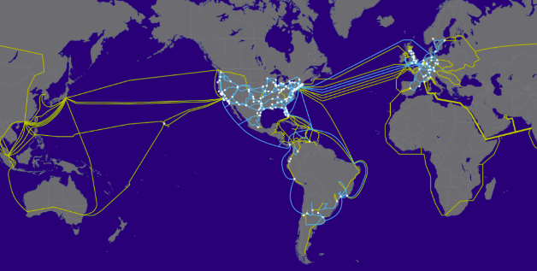
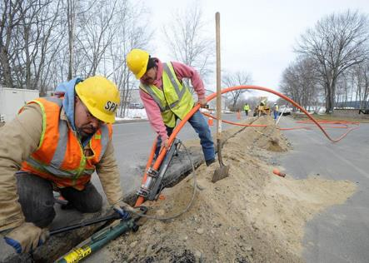






Wide-Area Networks (WANs)
The workhorses of today’s global Internet services.
Billion-dollar assets.
Must be efficiently utilized.
Level3 global backbone
Fiber optic cables

Slide 3
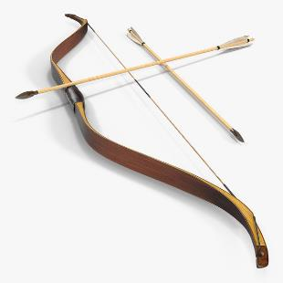
This talk: ARROW
Gain 2x throughput without compromising availability
in large-scale WANs.

Slide 4
Talk outline
Opportunity
System
Evaluations
State-of-the-art
Failed IP links can be restored.
Dynamically restore failed IP links with ARROW.
Impact of fiber cuts on WANs.
Gains of restoration-aware WANs

Slide 5


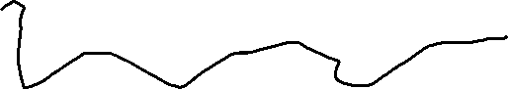
What is a WAN link?
Boston
San Francisco
Router
Router
IP link
Optical wavelength (λ)
Transponder
Transponder
Optical switch
Optical switch
Router
Router
Fiber
Amplifier
5

Slide 6




WAN’s IP/optical topology mapping
IP layer
A
B
C
D
WAN operators’ goal
Maximizing network throughput while maintaining high availability.
Optical layer
A
B
C
D
6

Slide 7
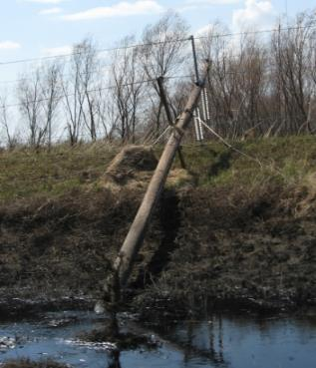
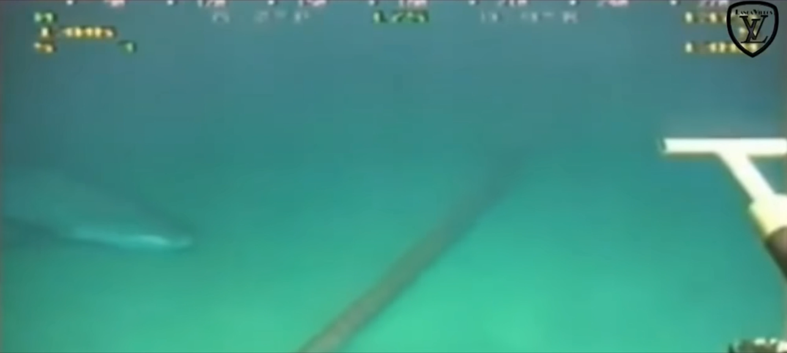
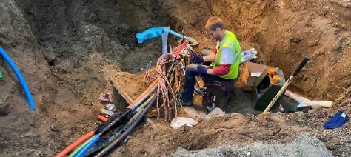
Problem: fiber cuts are common at large scale
https://www.youtube.com/watch?v=VVJlKJi9FWU
http://users.ece.utexas.edu/~kwasinski/ikegrid.html
https://www.kfyrtv.com/content/news/Cut-cables-in-Minot-leads-to-Internet-outage-570098031.html

Slide 8
Fiber cuts take down several Tbps IP capacity
9 hours
9 am 6pm
9/2017 12/2017 3/2018 6/2018 9/2018

Slide 9
State-of-the-art approach to cope with fiber cuts
Backup IP2
IP layer
IP2
A
B
C
D
State-of-the-art approach
IP1
Needs backup link to maintain availability.
Requires extra router ports & transponders for backup links.
Backup IP1
Backup λ2
λ2
Optical layer
A
B
C
D
λ1
Backup λ1

Slide 10
Talk outline
Opportunity
System
Evaluations
State-of-the-art
Failed IP links can be restored.
Dynamically restore failed IP links with ARROW.
Impact of fiber cuts on WANs.
Gains of restoration-aware WANs.

Slide 11
ARROW: Agile Restorable Optical Wavelengths
Restored IP2
IP layer
IP2
Key idea in ARROW
A
B
C
D
IP1
Reconfiguring wavelengths to restore lost IP capacity.
No redundant router ports or transponders.
Restored IP1
Restored λ2
λ2
Optical layer
A
B
C
D
λ1
Restored λ1
11

Slide 12
How to plan IP/optical restoration?
Iterate over all plausible fiber cut scenarios on the optical layer.
[Optical layer]
Decide on restoration plan for each fiber cut scenario.
Feed into traffic engineering optimization.
[IP layer]

Slide 13
Is there enough room in the optical fibers?
62% of fibers are partially restorable
Fiber restoration ratio (%)

Slide 14


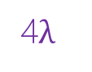

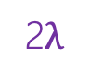
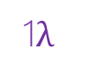







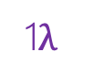
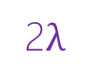
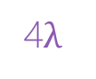
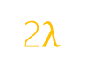





Challenge: partial restoration
4$λ$
Full restoration
A
B
C
D
8$λ$
3 free wavelengths
1$λ$
8$λ$
3$λ$
2$λ$
A
B
C
D
A
B
C
D
A
B
C
D
4$λ$
1$λ$
1$λ$
Partial restoration
Many partial restoration candidates with the same restored capacity!
1$λ$
2 free wavelengths
1$λ$
2$λ$
2$λ$
Optical-layer network
1$λ$
1$λ$
A
B
C
D
A
B
C
D
1$λ$
1$λ$
2$λ$

Slide 15


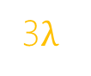
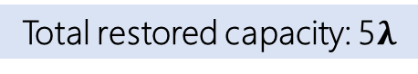


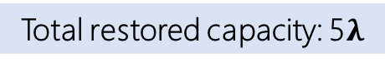


Example of partial restoration challenge
Demand: 400 Gbps
Satisfied demand: 200 Gbps
Satisfied demand: 400 Gbps
IP layer
A
B
C
D
A
B
C
D
A
B
C
D
Demand: 100 Gbps
Satisfied demand: 100 Gbps
Satisfied demand: 100 Gbps
Throughput = 500 Gbps
Throughput = 300 Gbps
Throughput = 500 Gbps
3 free wavelengths
2$λ$
8$λ$
1$λ$
3$λ$
Optical layer
B
C
D
B
C
D
B
C
D
A
A
A
4$λ$
1$λ$
1$λ$
2 free wavelengths
1$λ$
1$λ$
Healthy state
Total restored capacity: 5$λ$
Total restored capacity: 5$λ$
Restoration candidate 1
Restoration candidate 2

Slide 16
Handling partial restoration
Question
Which partial restoration candidate leads to the best network throughput?
ARROW’s approach
Devise a novel LotteryTickets abstraction to augment IP-layer traffic engineering with optical-layer restoration awareness.

Slide 17
Talk outline
Opportunity
System
Evaluation
State-of-the-art
Failed IP links can be restored.
Dynamically restore failed IP links with ARROW.
Impact of fiber cuts on WANs.
Gains of restoration-aware WANs.

Slide 18

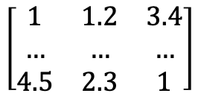

Ideal solution: cross-layer IP/optical traffic engineering
IP layer
Optical layer
$$\left[\begin{matrix}1 & 1.2 & 3.4 \\ … & … & … \\ 4.5 & 2.3 & 1\end{matrix}\right]$$
…
Traffic demand
IP topology
Optical topology
Set of failure scenarios
Cross-layer formulation
Traffic splitting ratio
Restoration plan
Integer-linear program (ILP)
Billions of variables for today’s WANs! Computationally intractable.

Slide 19
Root causes for computational intractability
IP layer constraints
IP and optical layers are orthogonal in problem space.
Mapping between IP links and their corresponding wavelengths is binary.
Problem space
Optical layer constraints

Slide 20

ARROW’s key technique: LotteryTicket abstraction
IP layer constraints
Solve the optical layer integer problem offline, and record solutions (failed IP links’ restorable capacity) as LotteryTickets.
Only feed LotteryTickets into IP-layer traffic engineering.
Solutions as LotteryTickets
Problem space
Offline solve
Optical layer constraints

Slide 21



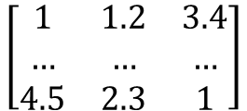
ARROW traffic engineering system
IP layer
Lottery Tickets
Optical layer
$$\left[\begin{matrix}1 & 1.2 & 3.4 \\ … & … & … \\ 4.5 & 2.3 & 1\end{matrix}\right]$$
…
Set of failure scenarios
Traffic demand
IP topology
Optical topology
Offline calculated with Randomized Rounding
ARROW’s formulation
Cross-layer formulation
Restoration candidates
Linear program (LP)
Fast runtime on today’s WANs.
Traffic splitting ratio
Restoration plan

Slide 22
Handling wavelength reconfiguration
Question
Can the optical hardware support fast wavelengths reconfiguration?
Decades-old challenge
Amplifiers add several minutes of delay when reconfiguring wavelengths.
ARROW’s approach
Use noise to avoid amplifier adjustments by fully populating the fibers.

Slide 23
How fast can we reconfigure wavelengths?
𝜆1
Power
Bottom fiber’s active wavelength number changed (λ1 -> λ1+λ2)
Wavelength frequency on top fiber
Optical switch
Optical switch
λ1
failure
Bottom fiber’s amplifiers adjustment required
A
B
λ2
Amplifier
Reconfigured λ1
Amplifier adjustments takes minutes
𝜆1
𝜆2
Power
Wavelength frequency on bottom fiber

Slide 24
Noise loading bypasses amplifier adjustments
𝜆1
Power
Bottom fiber’s active wavelength number (λ1+λ2) is constant
Wavelength frequency on Fiber1
Optical switch
Optical switch
failure
λ1 data
No adjustments to amplifiers
A
B
λ2 data
Amplifier
Noise source
λ1 carrying noise
Noise source
λ1 data
Amplifier adjustment delay can be saved
𝜆1 carrying noise
𝜆1
𝜆2
Power
Wavelength frequency on Fiber2

Slide 25
Talk outline
Opportunity
System
Evaluation
State-of-the-art
Failed IP links can be restored.
Dynamically restore failed IP links with ARROW.
Impact of fiber cuts on WANs.
Gains of restoration-aware WANs.

Slide 26
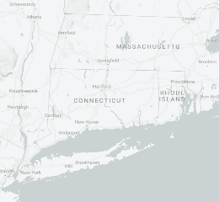
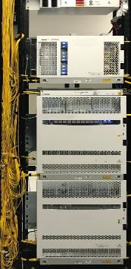
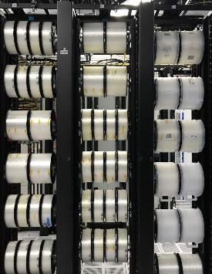
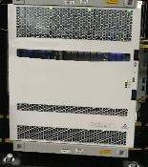
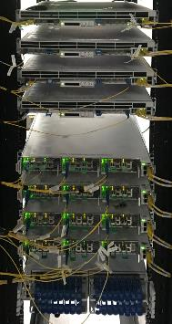
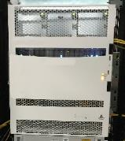


Production testbed
A
D
C
B
360 km
B
A
180 km
140 km
C
D
200 km
Optical switch
2160 km fiber
Amplifiers
Optical Transponders
Amplifier (EDFA)
Transponders

Slide 27
A fiber cut restoration trial
λ9 – λ14
Router B
Router A
Router B
Router A
Router B
Router A
IP layer
Router C
Router D
Router C
Router D
Router C
Router D
Reconfiguring 14 wavelengths:
17 minutes (State-of-the-art) -> 8 seconds (ARROW).
λ1 – λ2
λ1 – λ2
λ1 – λ2
λ9 – λ14
λ15 – λ16
B
A
B
A
B
A
Optical layer
λ3 – λ8
λ3 – λ8
λ3 – λ8
failure
failure
C
D
C
D
C
D
λ9 – λ14
λ15 – λ16
λ9 – λ14
λ15 – λ16
(a) Healthy network
(b) Network under fiber cut
(c) Restored network

Slide 28
Simulation setup
Topology |  |  |  |  | Traffic matrix | Tunnel selection | Baseline TE algorithms
Name | # routers | # IP links | # optical switches | # fibers
B4 | 12 | 52 | 12 | 19 | Traffic trace from SMORE [NSDI’18] | Fiber-disjoint paths & k-shortest paths | FFC [SIGCOMM’14] ECMP [TON’16] TeaVaR [SIGCOMM’19]
IBM | 17 | 85 | 17 | 23
Facebook | 34 | 262 | 84 | 156 | production traffic trace (sample every 30 minutes)

Slide 29
Simulation results: availability
better
99.9%
2x more traffic
FFC
[SIGCOMM’14]
ECMP
[TON’16]
TeaVaR
[SIGCOMM’19]
ARROW
(80 LotteryTickets)
ARROW (1 LotteryTicket)
By reconfiguring wavelengths to restore failed IP links, we carry 2x more traffic while maintaining a highly available network.

Slide 30
Simulation results: throughput
ARROW (1 LotteryTicket)

Slide 31
Concluding summary
ARROW is a traffic engineering system that reconfigures wavelengths during fiber cuts.
Our LotteryTicket abstraction makes cross-layer traffic engineering feasible at large scale to meet the stringent TE runtime requirement.
ARROW supports 2x – 2.4x more network throughput without compromising availability.
Code available at http://arrow.csail.mit.edu.

